Slide 1
COMPUTER FUNDAMENTALS
.
Operating System & Control System

Slide 2



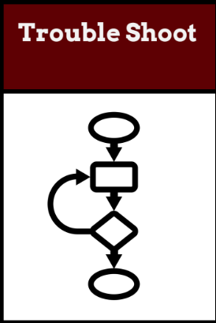
Do Now Activity (5 mins)
TOK
To what extent can data manipulation be considered an objective process when human judgment influences how databases are designed and interpreted?
L1 : Can you think of an analogy for how the OS abstracts hardware complexities? (Hint: Think of a translator or a waiter in a restaurant.)
L2:Explain what is Operating system with real life examples ?
L3: Mention what is a Control system with the support of an example.
Learning Intention: We'll explore their roles, functions, and how they manage the complex dance of hardware and software
Success Criteria:
Students will be able to analyse the flow of instructions through a pipeline and identify potential hazards.
Students will be able to evaluate the impact of pipelining on instruction throughput and execution time.
Students will be able to explain the advantages of multi-core processors for multitasking and parallel processing.

Slide 3
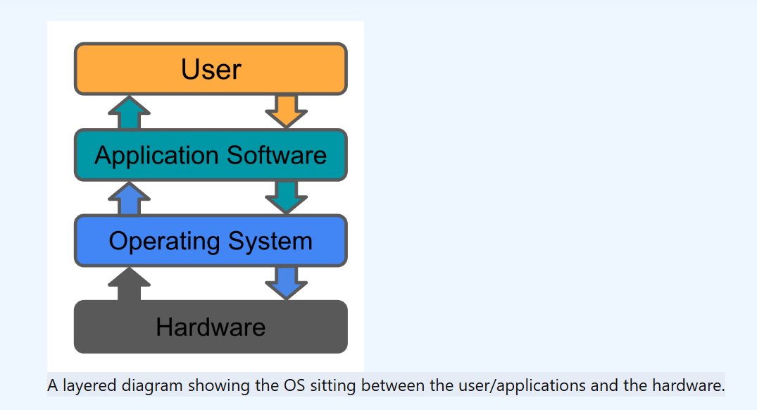

Slide 4
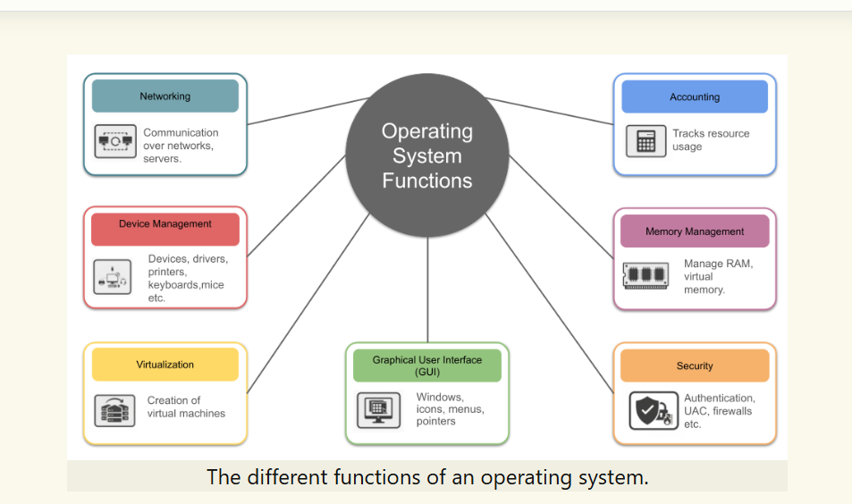

Slide 5
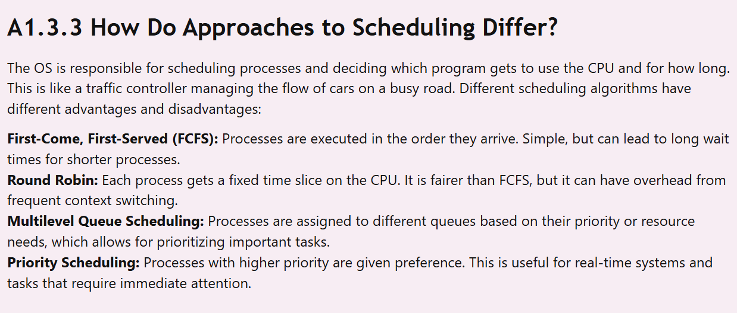

Slide 6
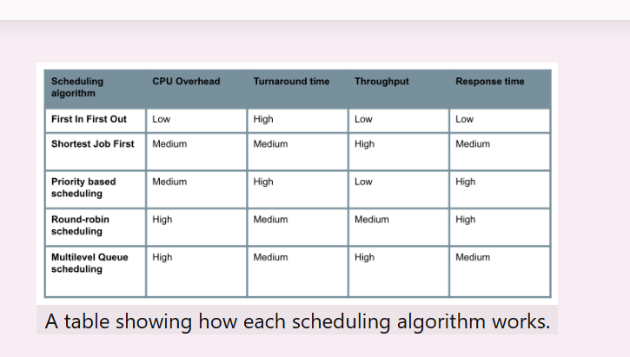

Slide 7
Challenging Activities - 20 mins
Table 1 : Explore and differentiate between polling and interrupt handling with an real life example.( Aditya Lead)
Table 2 : Explain why might interrupt handling be preferred for a keyboard, while polling might be more suitable for a network connection? (Youssef lead)
Table 3: What is the Role of the OS in Managing Multitasking and Resource Allocation? (HL only)(Sina lead)
Table 4 : Can you imagine a real-world scenario where each scheduling algorithm would be most suitable? Sketch and Explain - Usman (lead)

Slide 8
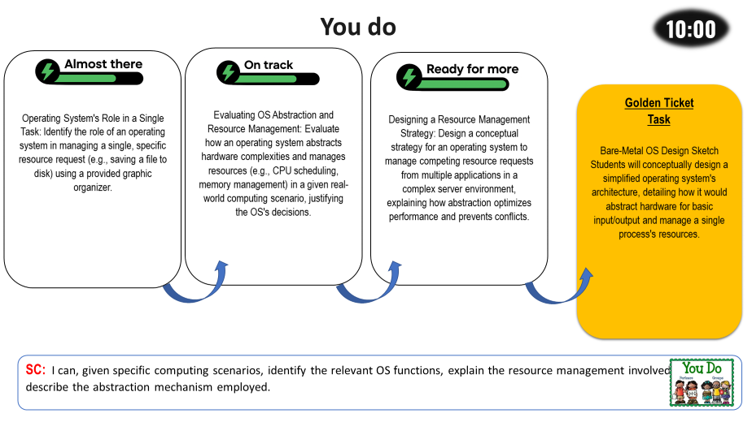
TASK 2

Slide 9
Plenary
Which of the following is NOT a core function of an operating system?
A. Running application software
B. Compiling source code
C. Providing a user interface
D. Managing system resources
What is the purpose of abstraction in an operating system?
A. To make the computer run faster
B. To prevent software crashes
C. To enable multitasking
D. To hide complex hardware details from users and applications
Which scheduling algorithm gives each process a fixed time slice on the CPU?
A. Round Robin
B. First-Come, First-Served
C. Multilevel Queue Scheduling
D. Priority Scheduling

Slide 10
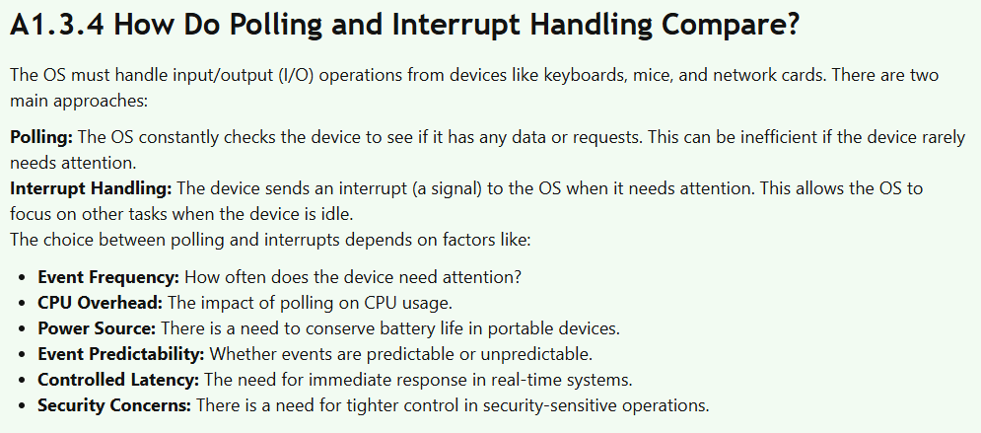

Slide 11
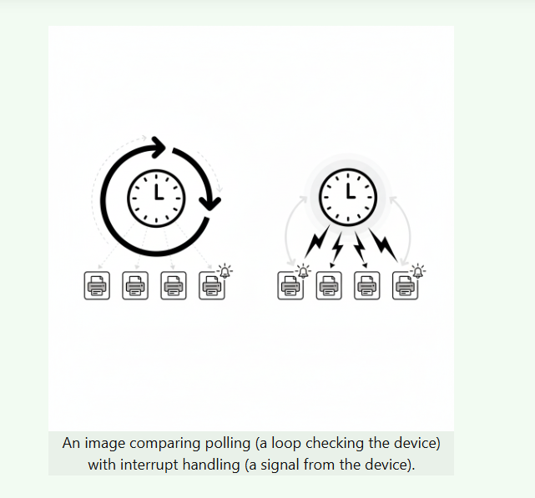

Slide 12
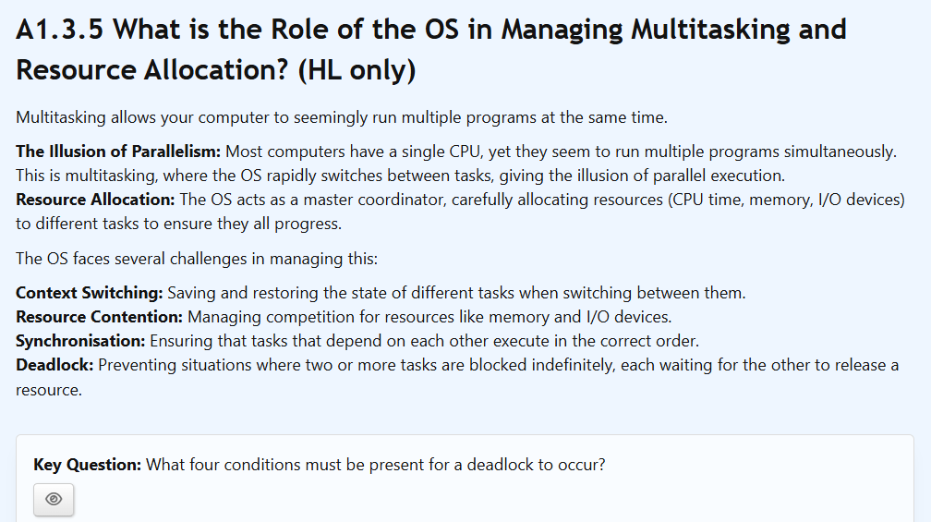

Slide 13
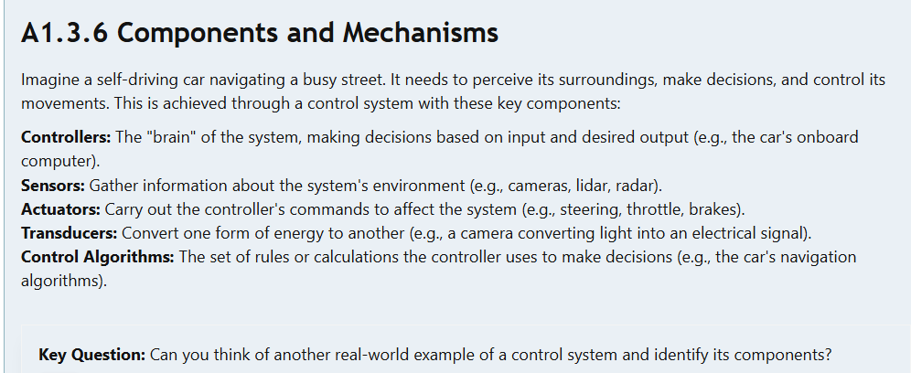
Control Systems

Slide 14
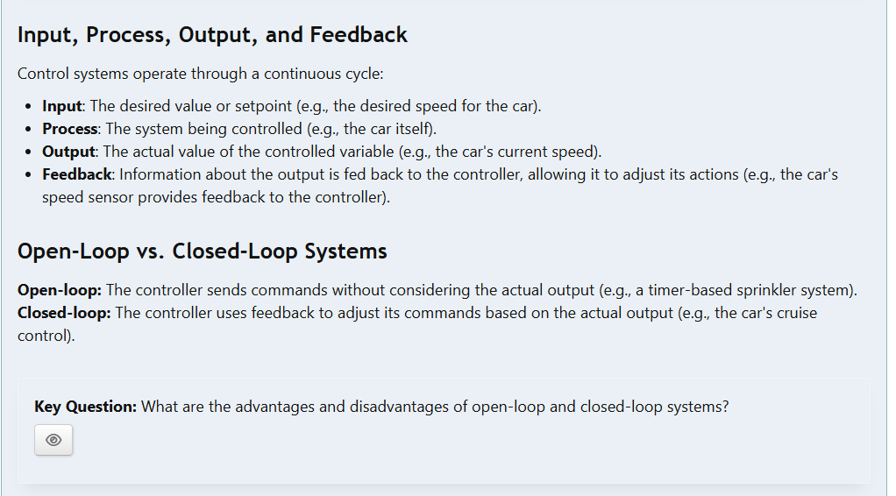

Slide 15
